Slide 1
Birds of the Wetland Practice #1
Naturesongs.com
And introduced Species

Slide 2
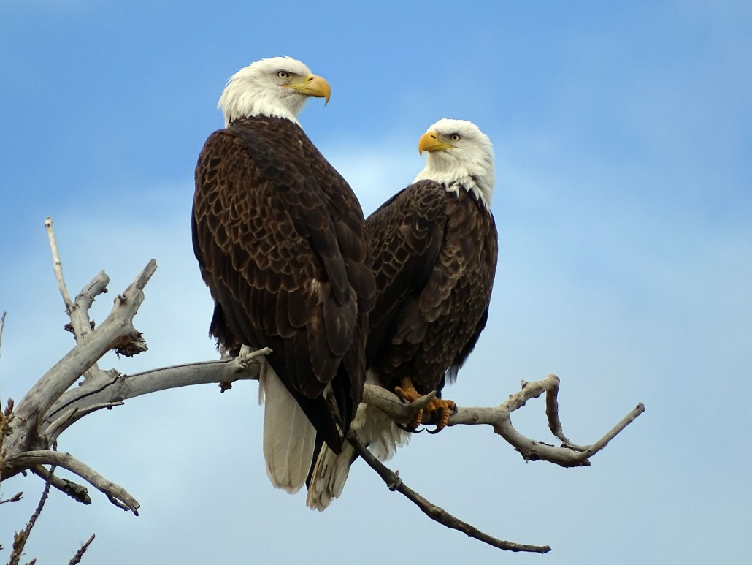
http://soundbible.com/981-Bald-Eagle.html#Bald%20Eagle%20Sound

Slide 3
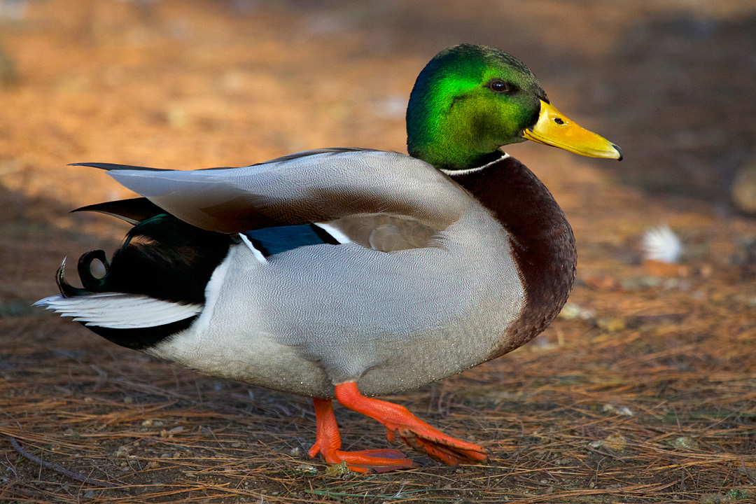


Slide 4
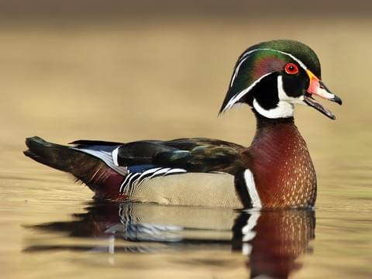

Slide 5
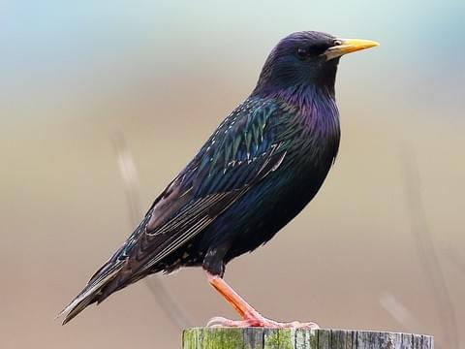

Slide 6
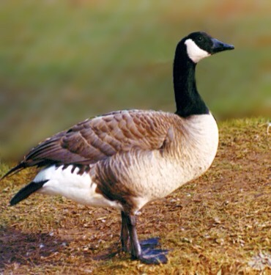

Slide 7
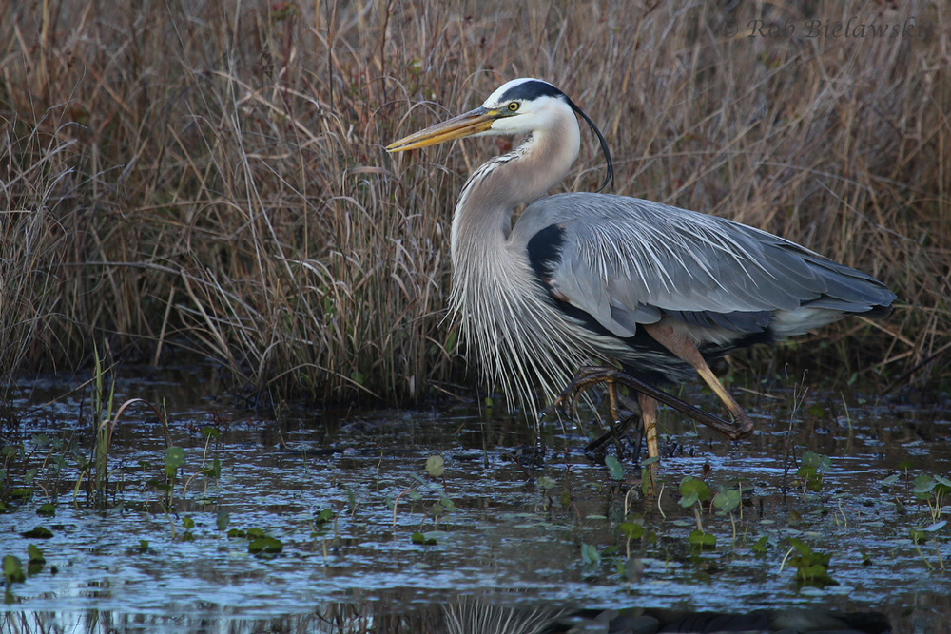

Slide 8
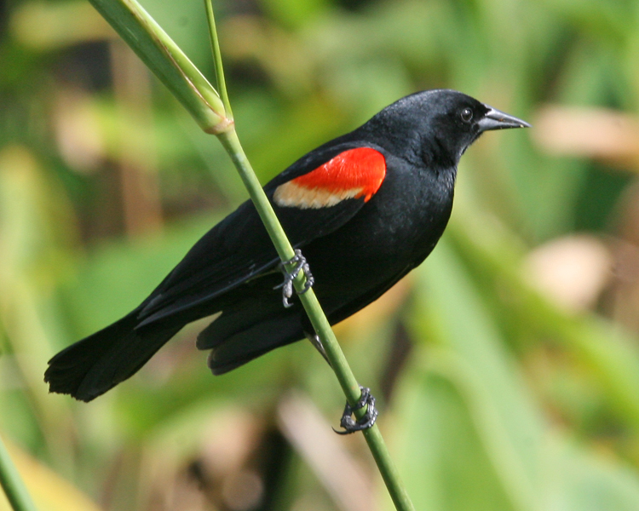

Slide 9
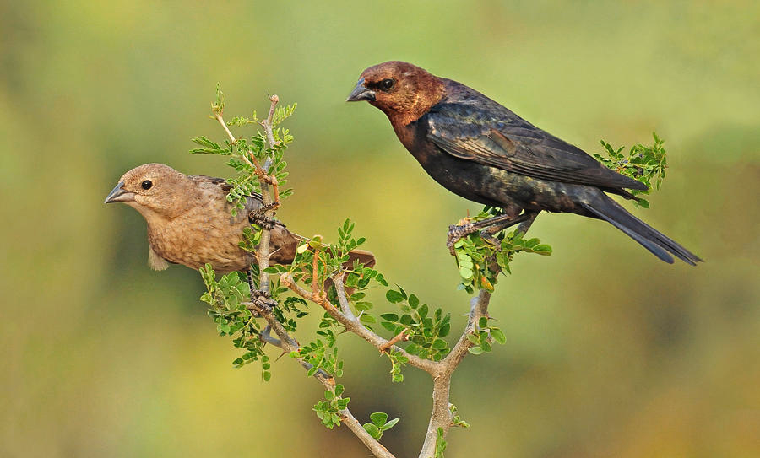

Slide 10
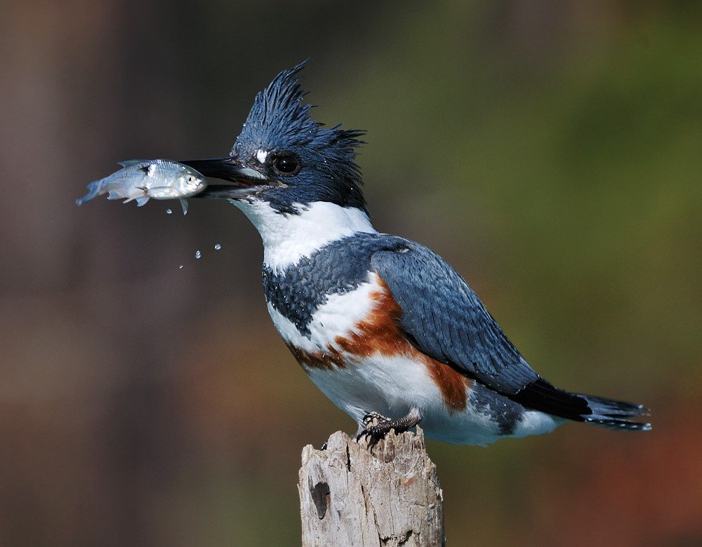

Slide 11
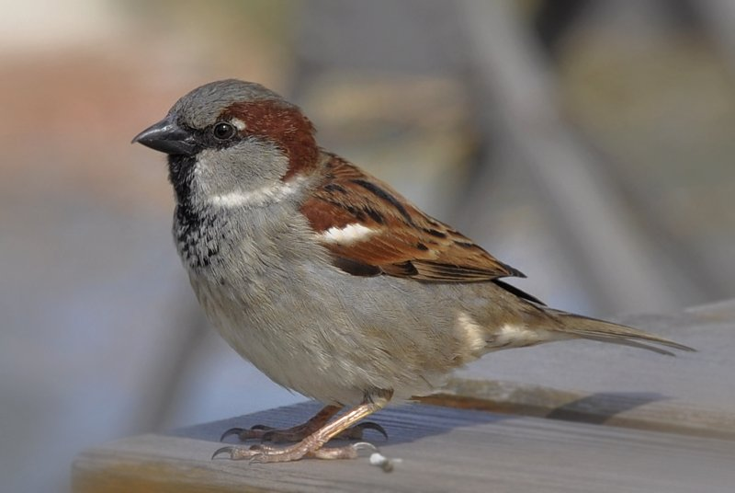

Slide 12
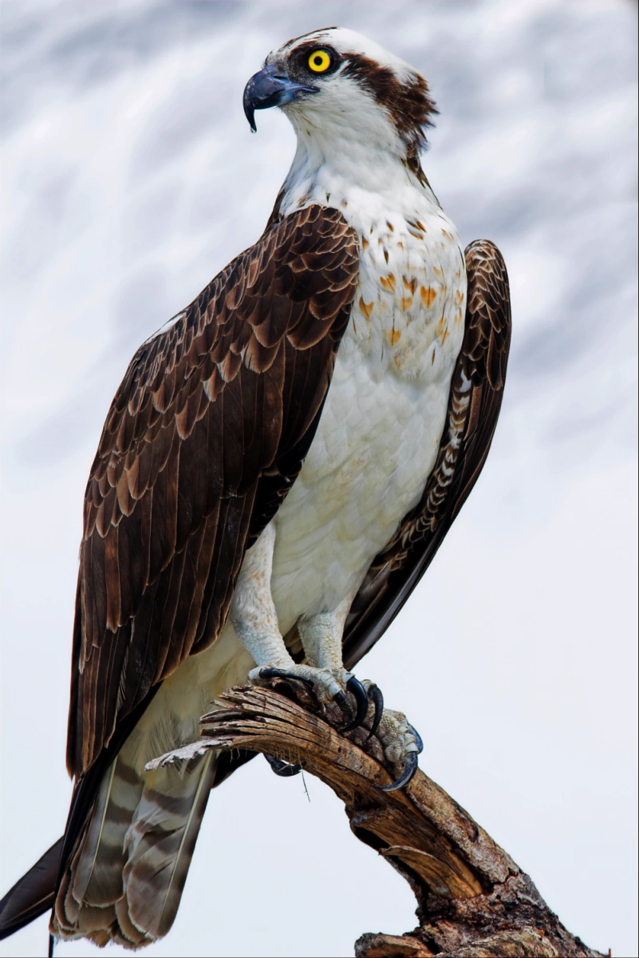

Slide 13
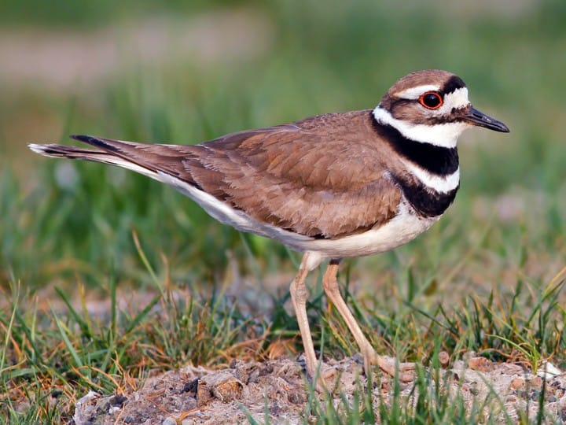

Slide 14
Answer key
1) title
2) Bald eagle
3) mallard duck
4) wood duck
5) European starling
6) Canada goose
7) great blue heron
8) red-winged blackbird
9) brown headed cowbird
10) belted kingfisher
11) house sparrow
12) osprey
13) killdeer

